Slide 1
Hidden Page
Teacher may follow the instructions below the pages to make the class effective.
Notes:
Please keep your eyes here to see instructions before going to slide show.

Slide 2

You are most welcome to my class dear students.
Notes:
Just go to the slide show, Teacher take 5 seconds here.

Slide 3
Introduction
Md Hasan Hafizur Rahman
Senior Lecturer Department of English Campus-5 Cambrian School & College, Dhaka | Class-8 English First Paper
Notes:
5 seconds .

Slide 4
Let us watch a video.
What have you watched in the video?
River Gypsy
Notes:
Teacher may let them watch the video to say some thing then……..

Slide 5
Our Today’s Lesson is-
River Gypsies in Bangladesh-2
Unit-7, Lesson-4
Notes:
Lesson declaration.

Slide 6
Learning outcomes
After we have studied this lesson. we will be able to---
ask and answer questions
read and understand the text
participate them in a short composition
Notes:
This will cover both speaking, listening, reading & writing skills.

Slide 7
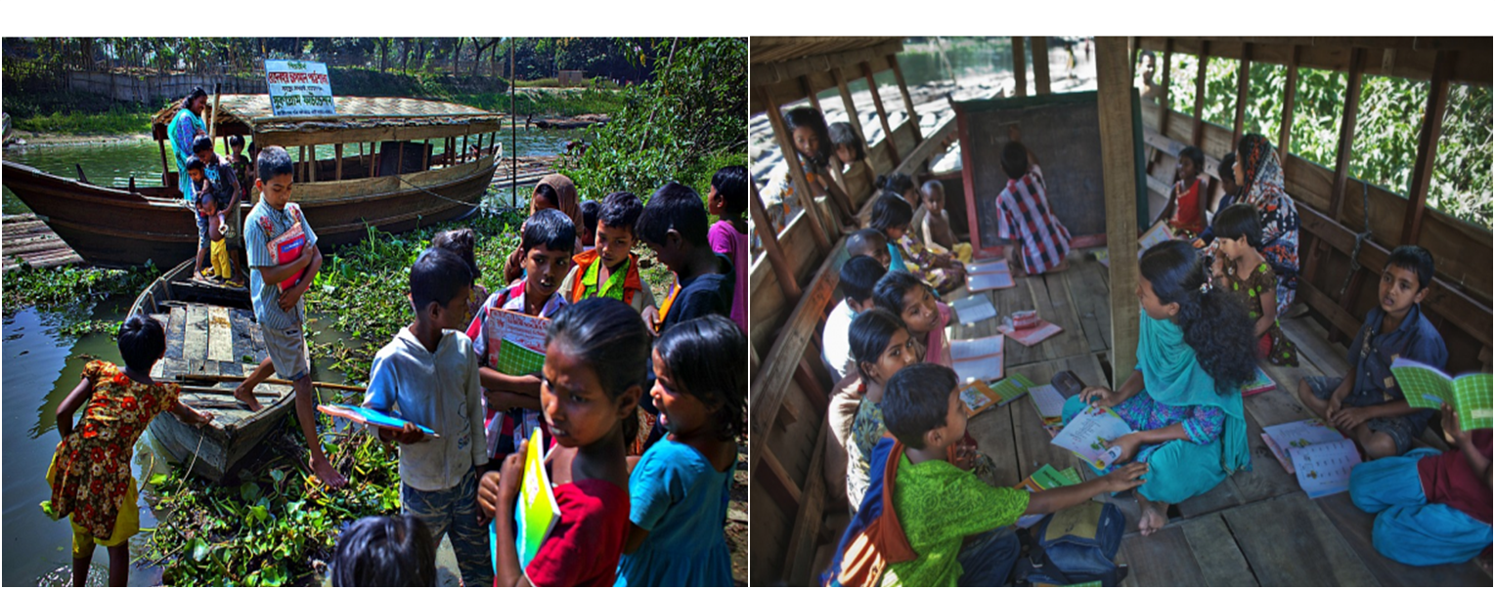
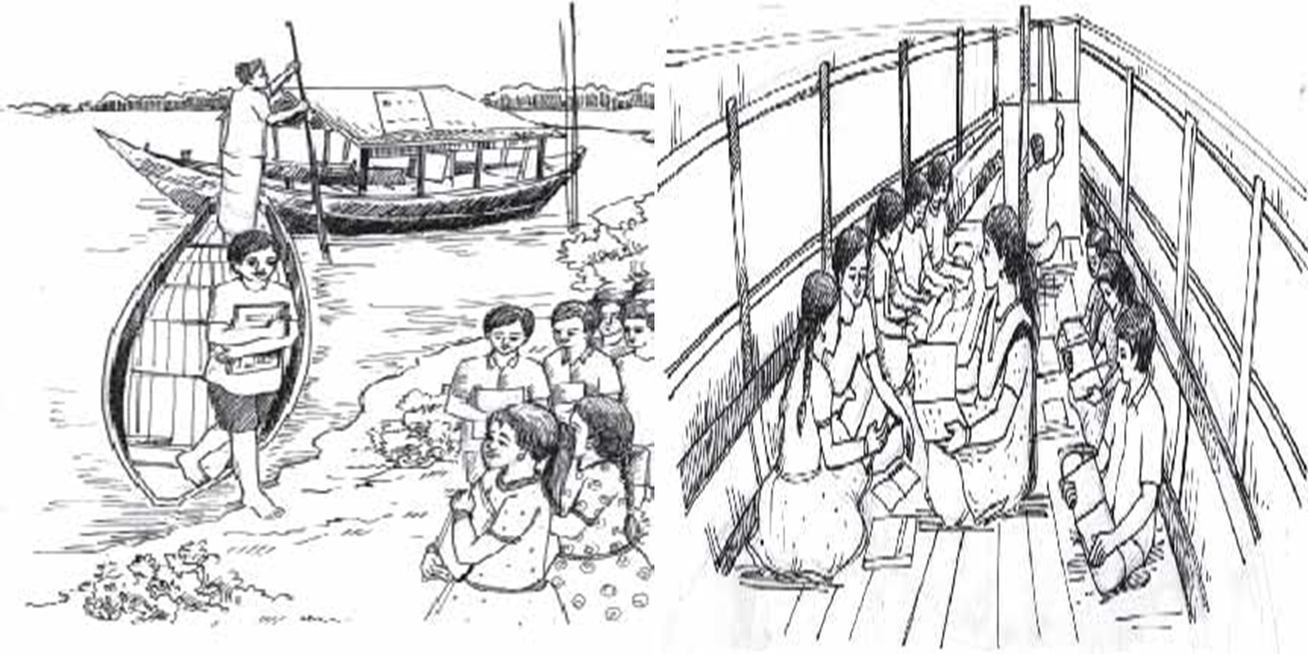

A Look at the pictures. Discuss with your partner and say who they are, where they are, what they are doing, etc.
Notes:
Teacher may ask the students to talk about the pictures with their partners. To go to text directly, please click right arrow.

Slide 8
Hidden page
If time may cover, teacher may show this option. If not, he may avoid this option. Teacher may show the word first and ask meaning. Then he may go ahead according to need.
Notes:
It is not mandatory. If teacher feels, he may conduct this option.

Slide 9
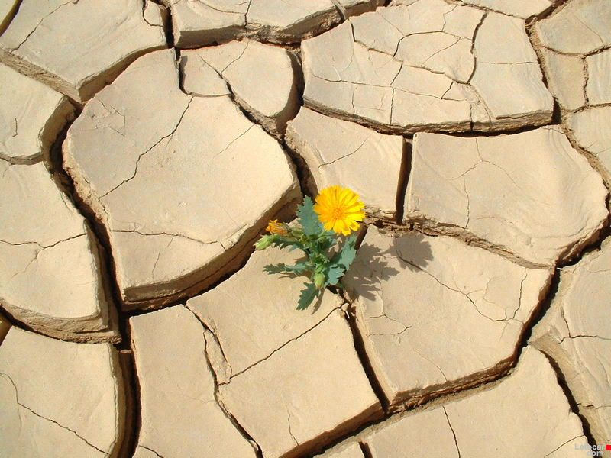
Survive
Meaning : Continue, stay alive, last
How beautifully the flower plant survives in such a rough soil!
Notes:
Teacher may show the word first, then ask the meaning, then he can show the details accordingly.

Slide 10

Used to
Meaning : in the habit of/ habit
I used to play football in my childhood.
Notes:
Teacher may show the word first, then ask the meaning, then he can show the details accordingly.

Slide 11

Inherit
Meaning : Heir, take over, get
She inherited a house from her mother.
Notes:
Teacher may show the word first, then ask the meaning, then he can show the details accordingly.

Slide 12
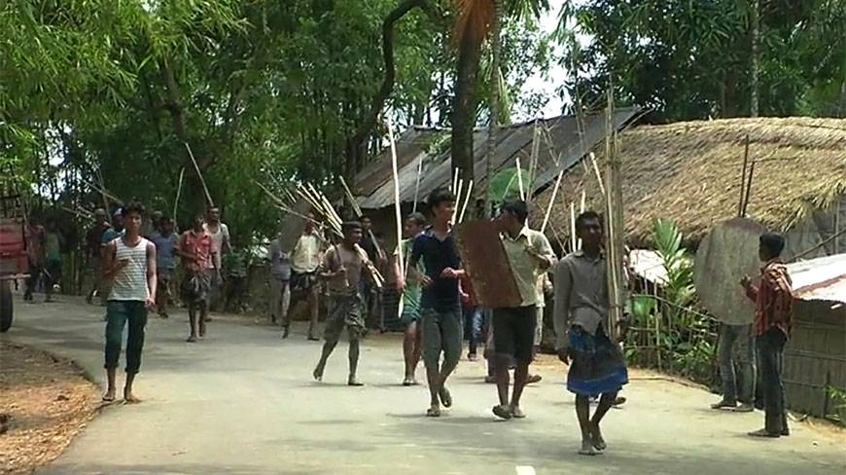
Mainstream
Meaning : locality, normal place,
In winter they came to mainstream.
Notes:
Teacher may show the word first, then ask the meaning, then he can show the details accordingly.

Slide 13
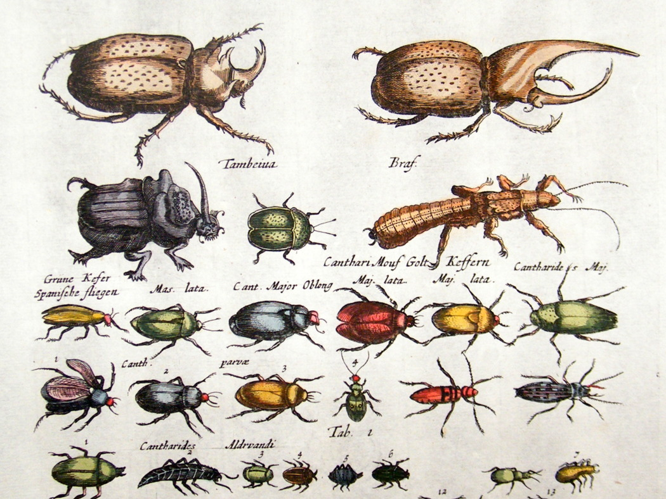
Petty
Meaning : small, miniature, little
All these are petty creatures.
Notes:
Teacher may show the word first, then ask the meaning, then he can show the details accordingly.

Slide 14

Trick
Meaning : Fake, false, bogus
I have understood your tricks.
Notes:
Teacher may show the word first, then ask the meaning, then he can show the details accordingly.

Slide 15
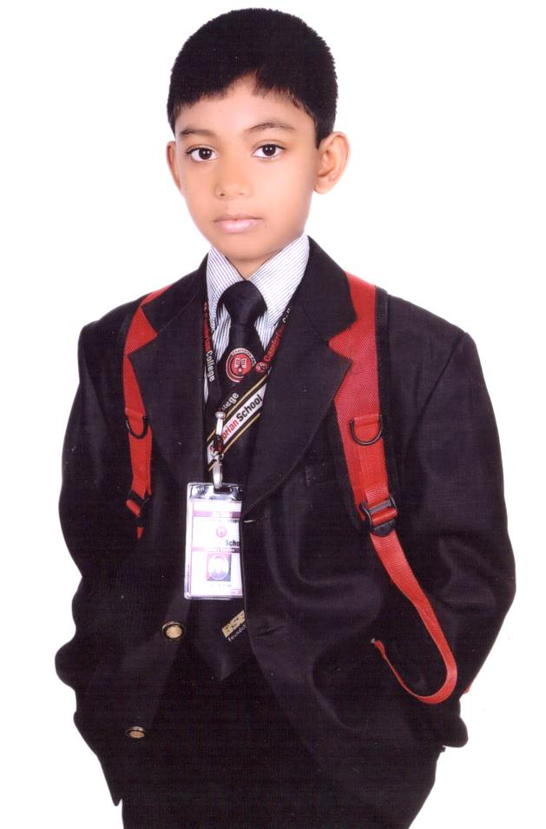
Integral part
Meaning : Thickened, integrate, undivided, unabated, undisputed, integral
Head is the integral part of the body.
Notes:
Teacher may show the word first, then ask the meaning, then he can show the details accordingly.

Slide 16
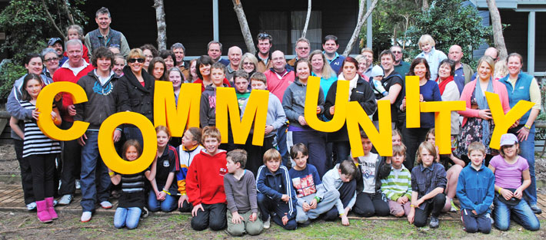
Community
Meaning: Community, people, sect, denomination, brotherhood, race
We live in a community.
Notes:
Teacher may show the word first, then ask the meaning, then he can show the details accordingly.

Slide 17
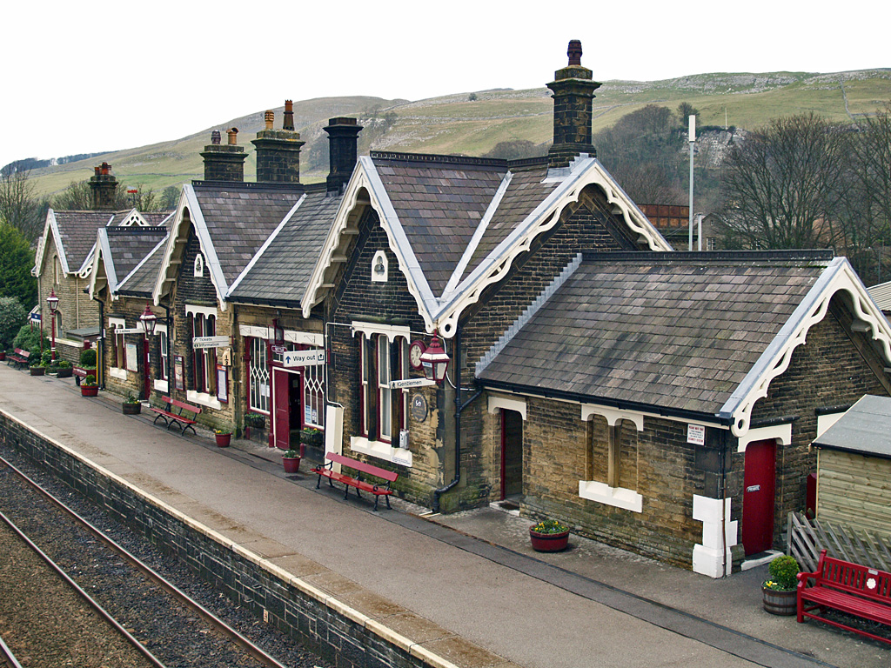
settle
Meaning: settle, colonize, colonialize
I was settled in London in 1970.
Notes:
Teacher may show the word first, then ask the meaning, then he can show the details accordingly.

Slide 18
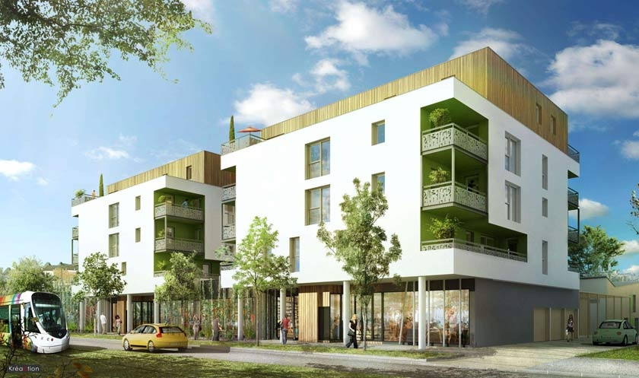
Urbanise
Meaning : Turn into city
All the places around Dhaka are urbanised.
Notes:
Teacher may show the word first, then ask the meaning, then he can show the details accordingly.

Slide 19
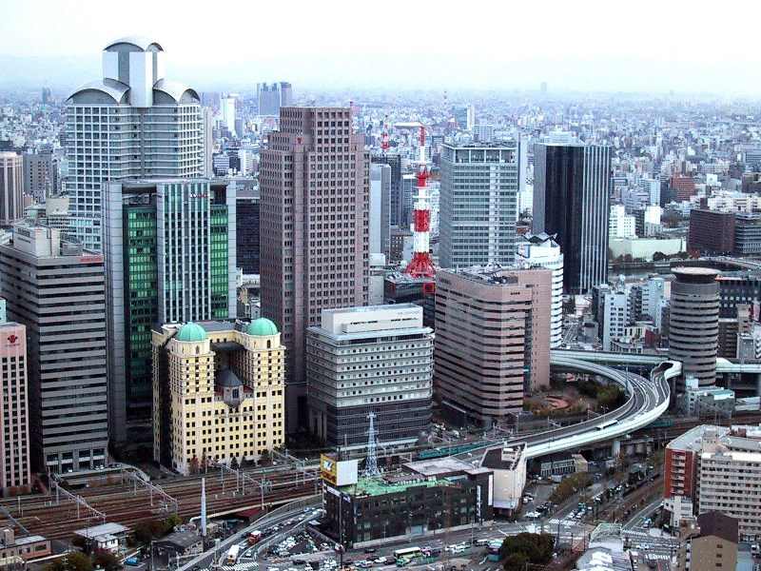
Urban
Meaning : City, town, corporation
We live in an urban area.
Notes:
Teacher may show the word first, then ask the meaning, then he can show the details accordingly.

Slide 20
B Read the text and answer the following questions.
River gypsies in Bangladesh are having various problems.
Let us see……
Notes:
First teacher may show the picture, then ask the students what they say and at last he may show the text and read out with proper sound, stress and intonation. He may explain the subject matter.

Slide 21
Firstly:
Urbanisation
Notes:
Teacher may show the picture, then ask the students to say something about it and at last teacher may show the text and read out with proper sound, stress and intonation. He may explain the subject matter then.

Slide 22
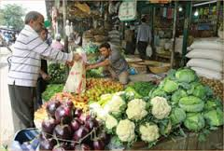
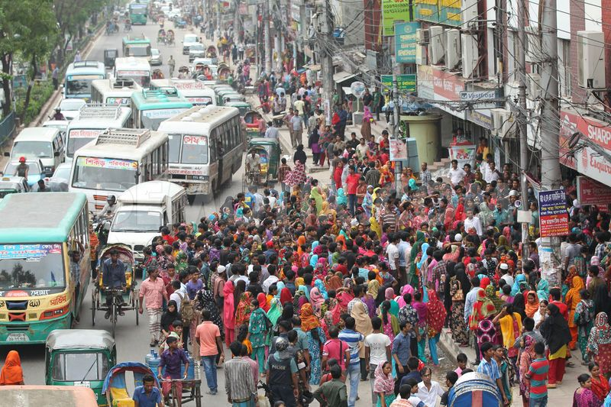
Losing
customer
for urban people.
Notes:
Teacher may show the picture, then ask the students to say something about it and at last teacher may show the text and read out with proper sound, stress and intonation. He may explain the subject matter then.

Slide 23
income is threatened.

Slide 24
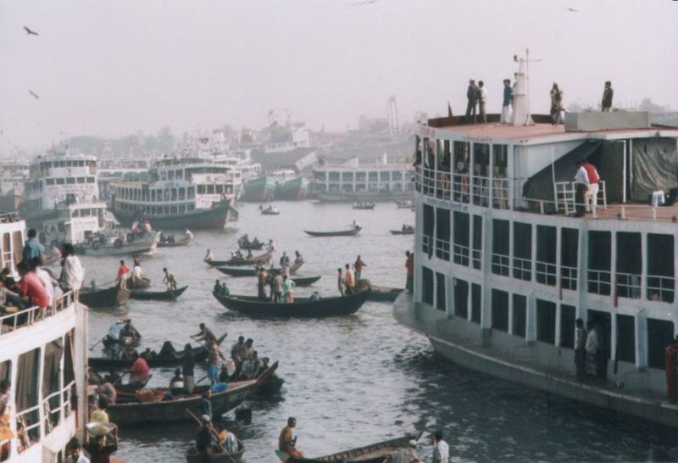
Secondly
Previous waterways
24,000 km
Present waterways
6,000 km
in dry season
Thus waterways are decreasing rapidly which is not favourable to the gypsies.
Notes:
Teacher may go according to animation.

Slide 25
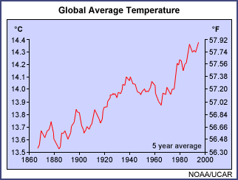
Scientists believe that Bangladesh will be worst affected by global climate change.
Notes:
Teacher may go according to animation.

Slide 26
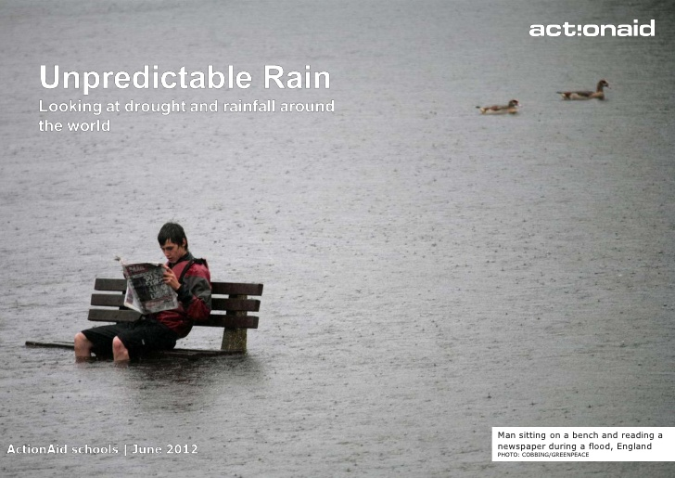
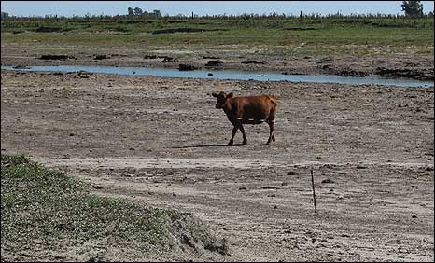
The unpredictable rain and drying out of rivers have made boat movement heavily restricted.
Notes:
Teacher may show the picture, then ask the students to say something about it and at last teacher may show the text and read out with proper sound, stress and intonation. He may explain the subject matter then.

Slide 27
Dear students!
Open your book page at 78 and go through from ‘Thirdly, many river gypsies are changing their………….children in some areas. Read silently.
Notes:
Instruction for the students.
Teacher may ask the students to open their books to read silently.

Slide 28
Thirdly, many river gypsies are changing their lifestyle in the context of changed reality. They are thinking of living permanently on land. The authority feels that river gypsies need help to survive in the mainstream population. Therefore, the government is offering voting rights, permanent housing and bank loan facilities. However, changes do not come overnight. Traditionally, river gypsies are used to water life. They have inherited from their forefathers necessary life skills to survive in waters. They have no education and training to adapt to mainstream modern society. So the authority feels the need to bring them under formal education network. But they have no permanent living place. Gypsy children are born and brought up on roaming boats. Therefore, they cannot go to conventional schools. And hence, mobile boat-schools are coming up for gypsy children. Some voluntary organisations are running special schools on boats to educate river gypsy children in some areas.
Notes:
This option is the students who have not brought books.

Slide 29
Answer the following questions
1 What are the main problems that river gypsies are facing?
2 What is the effect of global climate change in Bangladesh?
3 Why are many river gypsies thinking of changing their lifestyle?
4 Why can’t river gypsy children go to conventional schools?
5 Who are running special schools for river gypsy children? Why?
Notes:
This option may be conducted orally or written.

Slide 30
C Listen to the teacher/CD and tick the best answer.
U7, L5 C Listening text: 7
1 Bedeys catch snakes during the winter/rainy/summer season.
2 Females of the bedey families contribute to the family income/education/health with petty trades.
3 They sometimes go vending far from home by rickshaw/ on foot/ by cart.
4 Many bedeys have settled near the riverbanks/lakesides/sea shore.
5 Bedeys are an integral part of our history and literature/culture/tradition.
Notes:
This option may be conducted orally or written.

Slide 31
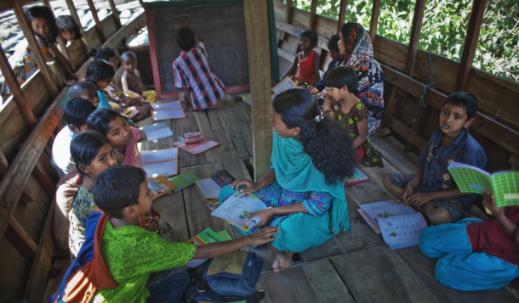
Home Work
D Imagine there is a boat-school in your area to teach river gypsy children.
Write a short composition about how you can help the gypsy children with learning.
Notes:
Teacher may instruct the students to write at home for next class.

Slide 32
Allah Hafiz

Slide 33
Acknowledgement
We would like to express our cordial gratitude to the Ministry of Education, Directorate of Secondary & Higher Education, NCTB, A2i and the panel of honorable editors ( Md. Jahangir Hasan, Assistant Professor (English) TTC, Rangpur, Ranjit Poddar, Associate Professor (English) TTC, Dhaka, and Urmila Khaled, Assistant Professor (English) TTC, Dhaka, to enrich the contents.

